Slide 1
Electrocatalysis MAP Project Questions
May 26, 2020

Slide 2


Introduction
Current Role: Robotics Lab Tech Co-Op (4 month Term)
Background:
4th year Automation Engineering @ McMaster
Past Experience:
Automation & Controls Engineer @ PepsiCo
(April 2018 – August 2019)

Slide 3
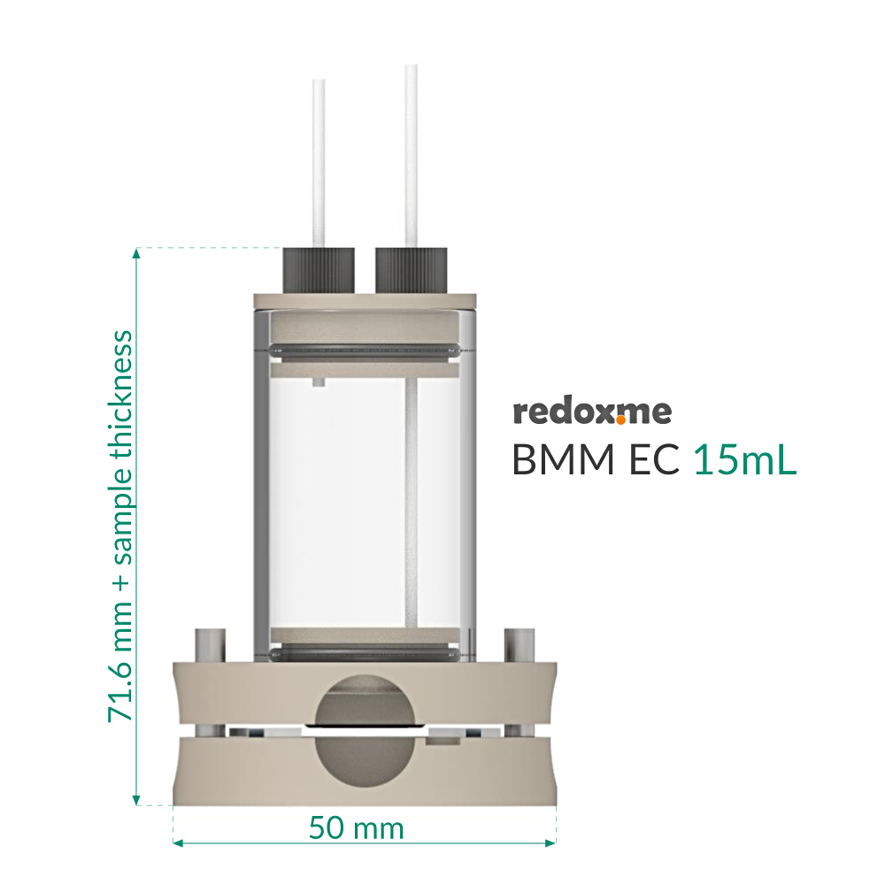
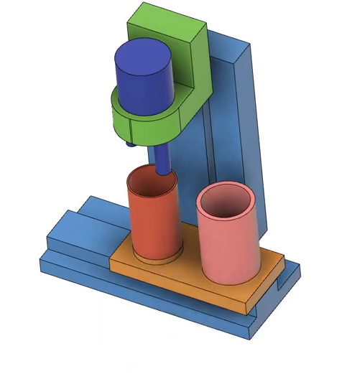
Electrochemical Cell Questions

Slide 4
Electrochemical Cell Design
Example Cell
After Modifications
Example Cell:
Redox BMM EC Cell
Proposed Changes:
Redesign the Sample Holder
Fuse Glass Chamber & Bottom Casing
Remove Magnetic Seal
Glass Chamber
Custom Machined Sample Holder
Sample Holder
Link to Cell
https://redox.me/collections/electrochemical-cells/products/bmm-ec-15ml-bottom-magnetic-mount-electrochemical-cell
Bottom Casing

Slide 5
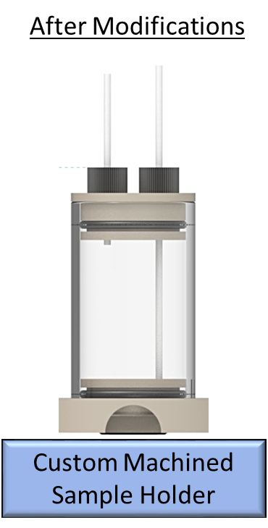
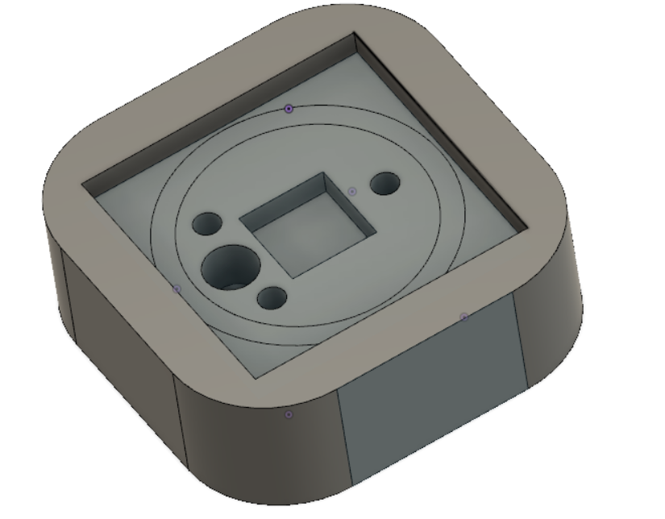
EChem Cell – Proposed Changes
*Initial Version of Sample Holder
Includes:
Embedded Glass Slide Holder
Embedded Camera
Fluid Spray (Under Glass Slide)
Fluid Drain
2
1
3
4

Slide 6
Glass Chamber Lift – Proposed Changes
Replace Green Piece with Gripper
Utilize a High Torque Servo Motor for vertical motion
Procedure:
Grip Glass Chamber & Lift up
Robot Picks Up Glass Slide
Glass Chamber is brought down for washing
Lift Chamber again & place new glass slide

Slide 7
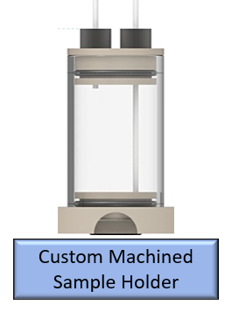
EChem Cell Questions
Are the Proposed Changes feasible?
How will the N9-200 Robot handle the Glass Slide?
Suction, Gripper or Other
What are your suggestions/vision for this project

Slide 8
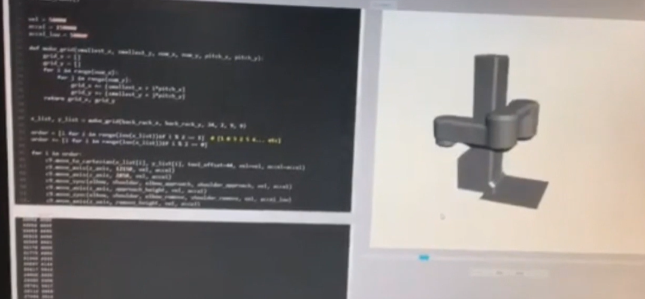
N9 IDE/Simulator - Questions
3D Simulator
What can be done?
Current Limitations
Can CAD Objects be imported ?

Slide 9
Extra

Slide 10
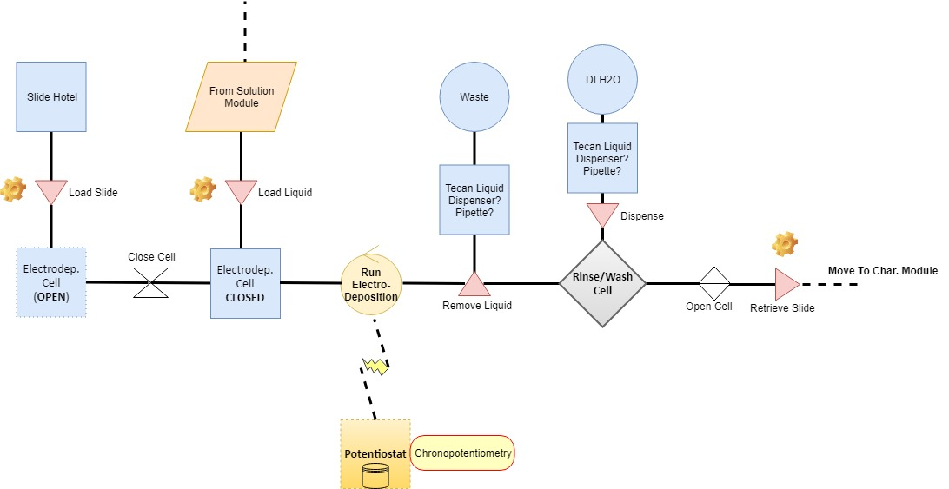
EChem Module Step 1 – ElectroDeposition

Slide 11
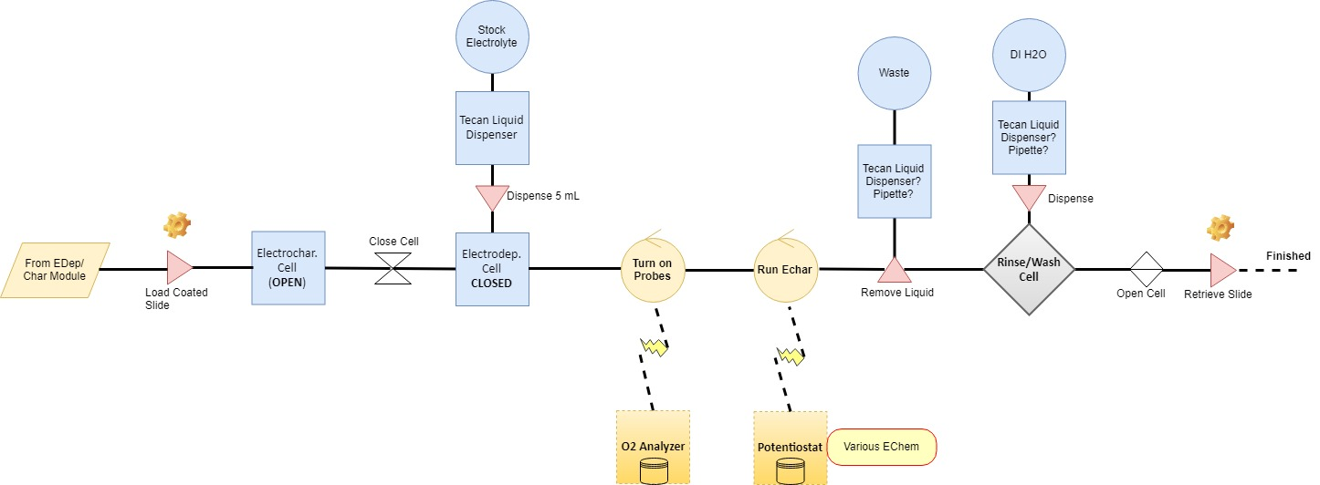
EChem Module Step 2 – ElectroCharacterization
Open cell here instead?

Slide 12
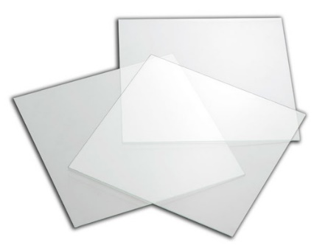
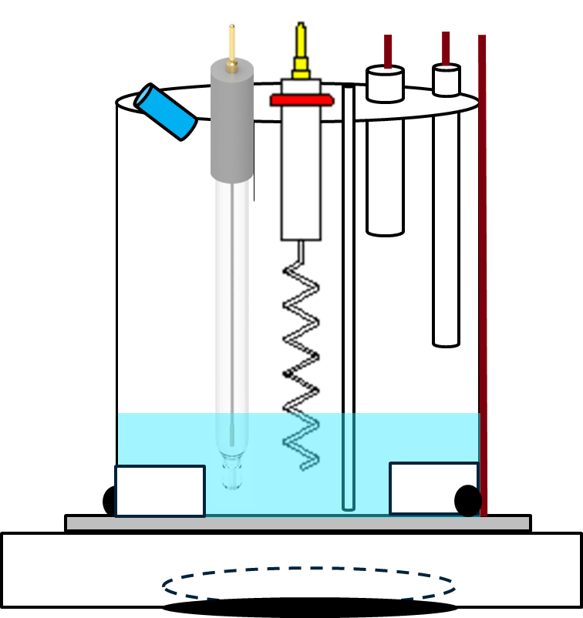
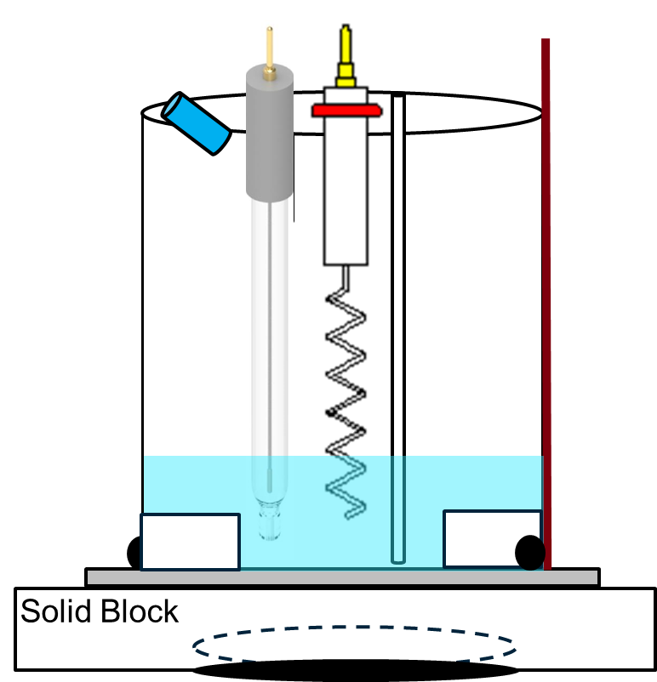
EChem Module – Sizing & Components
Deposition Cell
Area = 1.5 cm²
No O₂ Analyzer
No Agitation
Characterization Cell
Area = 1 cm²
Glass Slide
25 mm x 25 mm x 2.2 mm
(Can theoretically be any size)
>
Cell Body
Accommodate at least 5 mL of electrolyte
Still in development

